Slide 1
FOOD WASTAGE MONITORING SYSTEM
Supervisor
Dr. M. SRIDEVI
Head of the department
Data Science
Team Details
20EG110107 G.NAGENDER REDDY
20EG110113 K.KUMARA SRINIVAS REDDY
20EG110126 S.DHANUSH REDDY

Slide 2
Abstract
Problem Definition
Motivation
Objectives
Literature review
Existing System
Proposed System Architecture
S/W Requirements
Technologies Used
UML Diagrams

Slide 3
Abstract:
Food wastage monitoring system is a device which can be used to raise awareness about food waste in the canteen and encourage behavior change among students. The existing system lacks a mechanism to display the amount of food wasted, leading to a lack of awareness and accountability. To address this issue, we propose the implementation of a food waste display system.

Slide 4
Problem Definition:
Food wastage in college canteens is a significant issue that contributes to inventory loss, financial inefficiency and also spoils the college environment.
The lack of an efficient monitoring system results in overproduction, improper inventory management, and wasteful consumption practices. As a result, valuable resources are wasted, leading to increased costs and negative impacts.

Slide 5
Motivation:
According to the FSSAI (Food Safety and Standards Authority of India), one-third of all food in India is wasted or gets spoilt before it is eaten.
Our motivation for this project is to tackle the issue of food waste in our college canteen by implementing a Food Wastage Monitoring System.
We believe that by taking action at the canteen level, we can inspire a culture of sustainability within our college community and contribute to a more sustainable future.

Slide 6
Objective:
Raise Awareness: The primary objective of your project is to raise awareness among students about the amount of food wasted in the canteen.
Education and Empowerment: Our project aims to educate students about the consequences of food waste, such as its environmental impact and the social implications for communities.
Behavior Change: Through the display of food waste data, our project intends to inspire behavior change among students.

Slide 7
Existing System:
The current canteen setup does not have any mechanism to track or visualize the amount of food wasted.
In this case, we would like to highlight the lack of awareness among students and the absence of a means to measure or address the issue of food waste effectively.

Slide 8
Proposed System:
To address the food wastage issue in the college canteen, we propose implementing a Food Wastage Monitoring System using IoT devices. The system will utilize smart weighing scales, load cells, HX711,Arduino and IoT-enabled display units to measure the weight of food items and display it in real-time.The weight data will be saved using data logging devices for further analysis.

Slide 9
Installation of sensors and IoT devices: Implement sensors and IoT devices in various garbage bins of the canteen to monitor food disposal.
Data collection and analysis: Gather data from sensors and IoT devices, including food items purchased, prepared, consumed, and wasted. Analyze the collected data to identify patterns and trends.
Real-time monitoring: Develop a device to display real-time data on food waste levels.
Reporting and insights: Generate regular reports and insights based on the data analysis, highlighting areas of improvement and suggesting strategies to minimize food waste.

Slide 10
Software Requirements :
Front-End Technologies: HTML, CSS, and JavaScript are essential for creating the user interface and visual elements of the display system.
Thingspeak platform
Hardware Requirements:
Arduino UNO Board
LoadCell
Button
Buzzer
LED Display
Wifi Modular
Alink Board

Slide 11
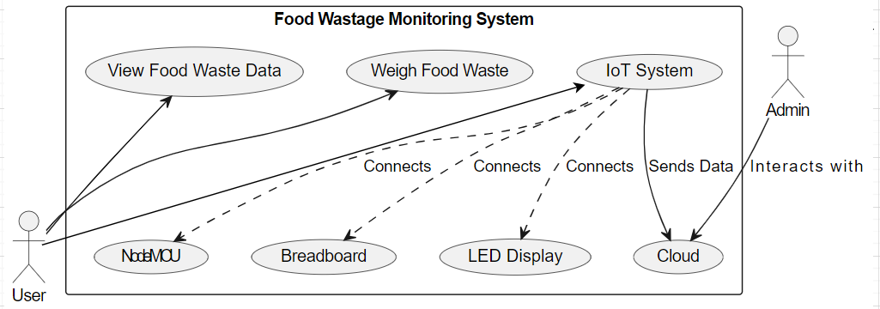
USECASE DIAGRAM:
Arduino
Alink Board

Slide 12
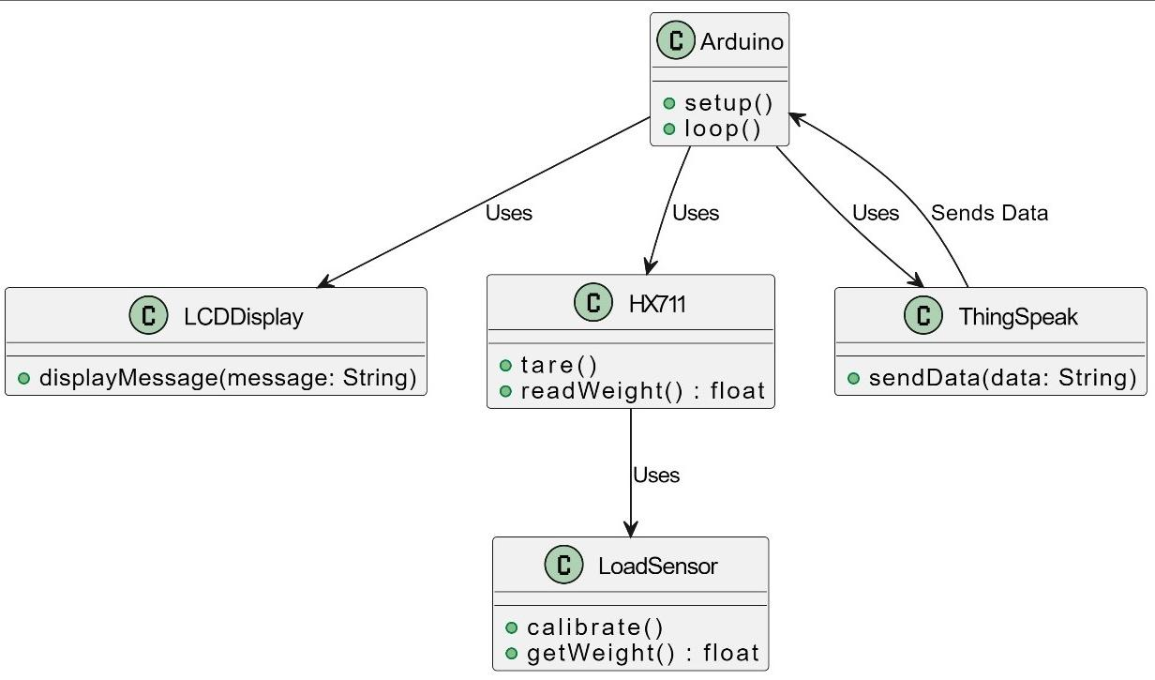
CLASS DIAGRAM:

Slide 13
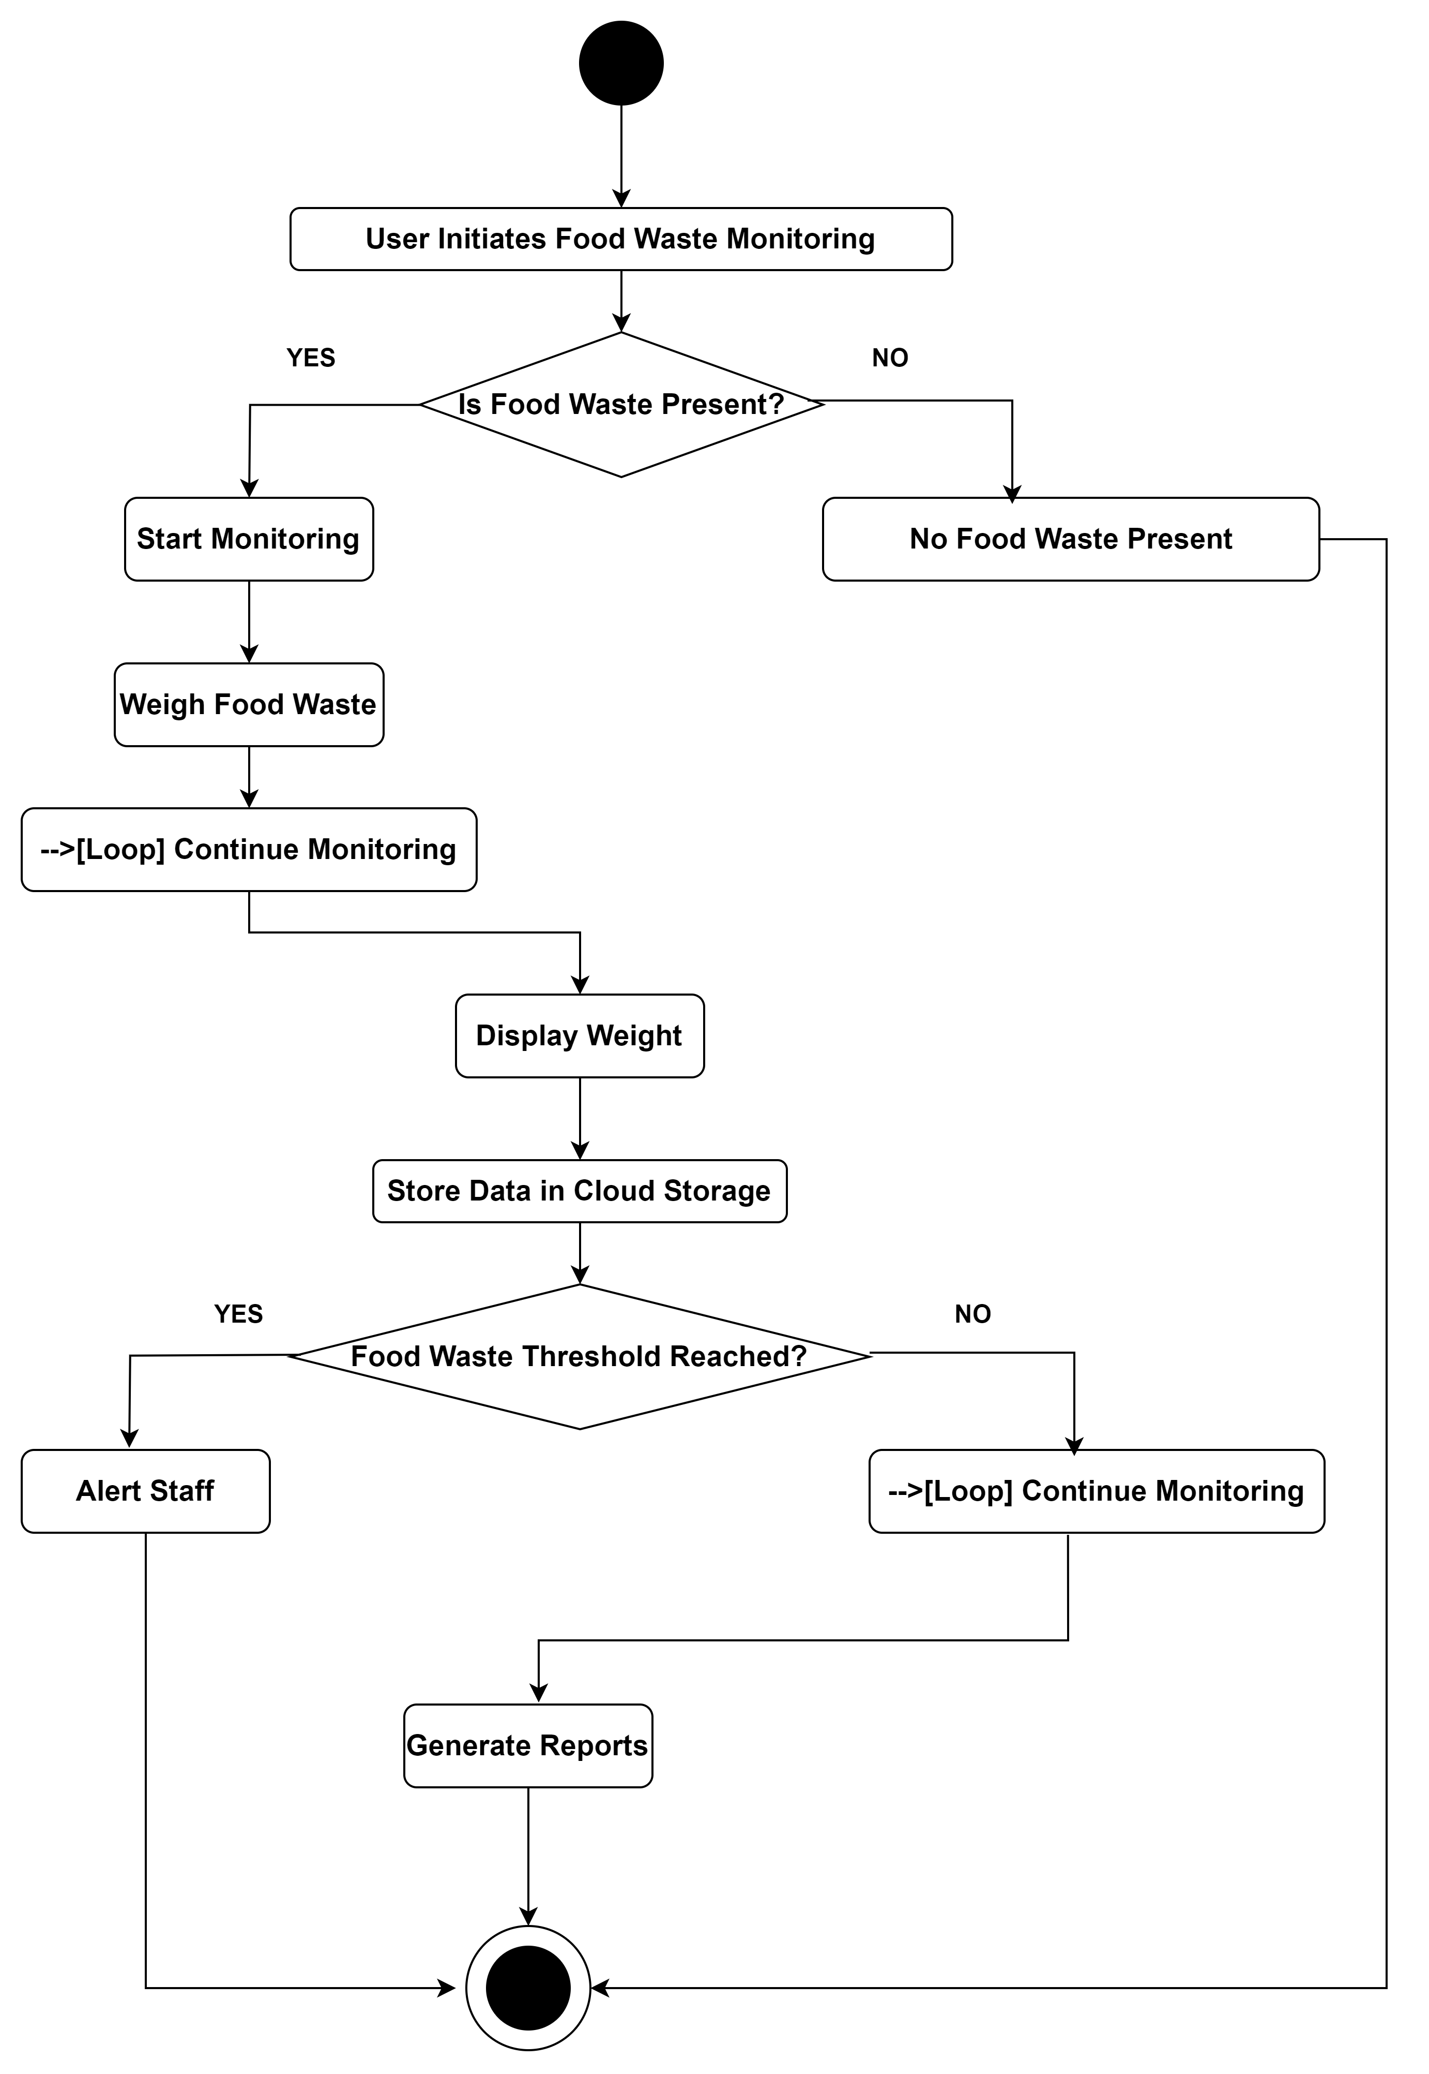
ACTIVITY DIAGRAM:

Slide 14
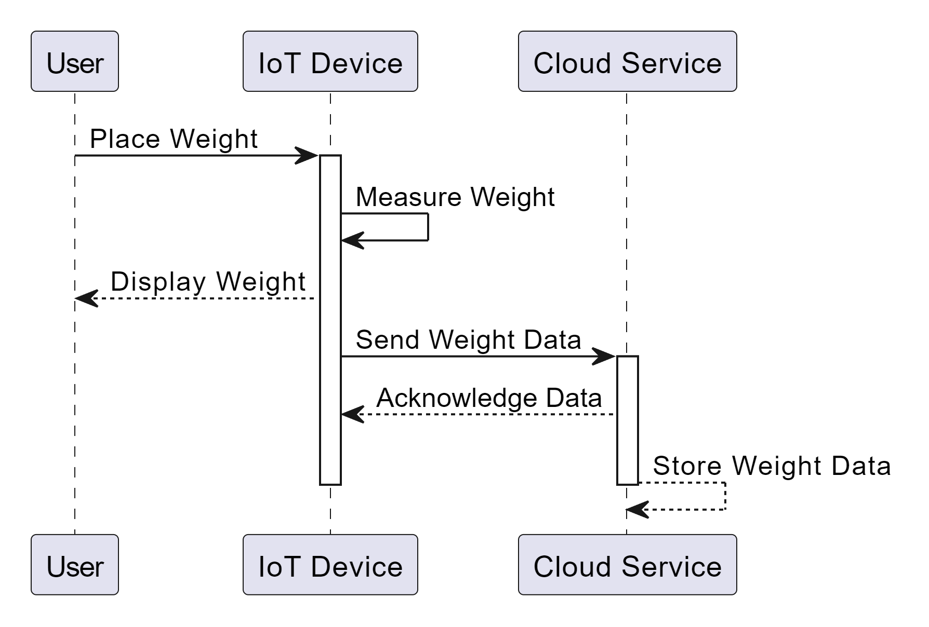
SEQUENCE DIAGRAM:
:
:
U:User
I:IOTdevice
C:CloudService
:
:
U:User
I:IOTdevice
C:CloudService

Slide 15
IMPLEMENTATION:
In this project, we are utilizing IoT devices to monitor food weights and display this information, aiming to make students more aware of the amount of food they are wasting. The connections are established using a load cell, HX711 amplifier, Arduino microcontroller, and a Alink Board for prototyping.
The data collected from these devices is transmitted to a cloud platform called ThingSpeak. This platform serves as the central repository where all collected data is stored, and it also provides tools for data visualization.
To enable data collection and transmission, a program is developed and loaded onto the ArduinoUNO using the Arduino development environment. This program facilitates the collection of weight data from the load cell, processes it, and then sends it to the ThingSpeak cloud platform for storage and visualization.

Slide 16
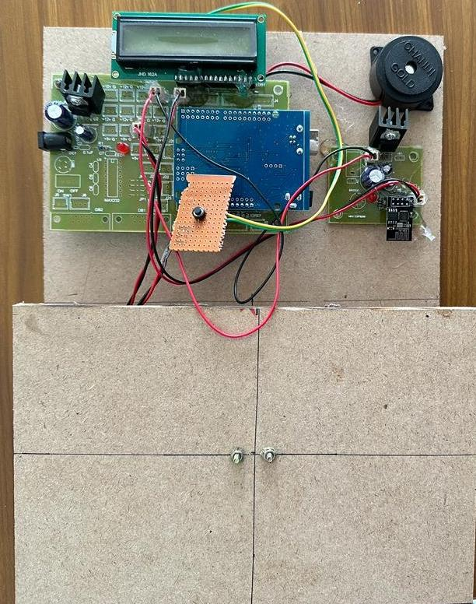
Connection:

Slide 17
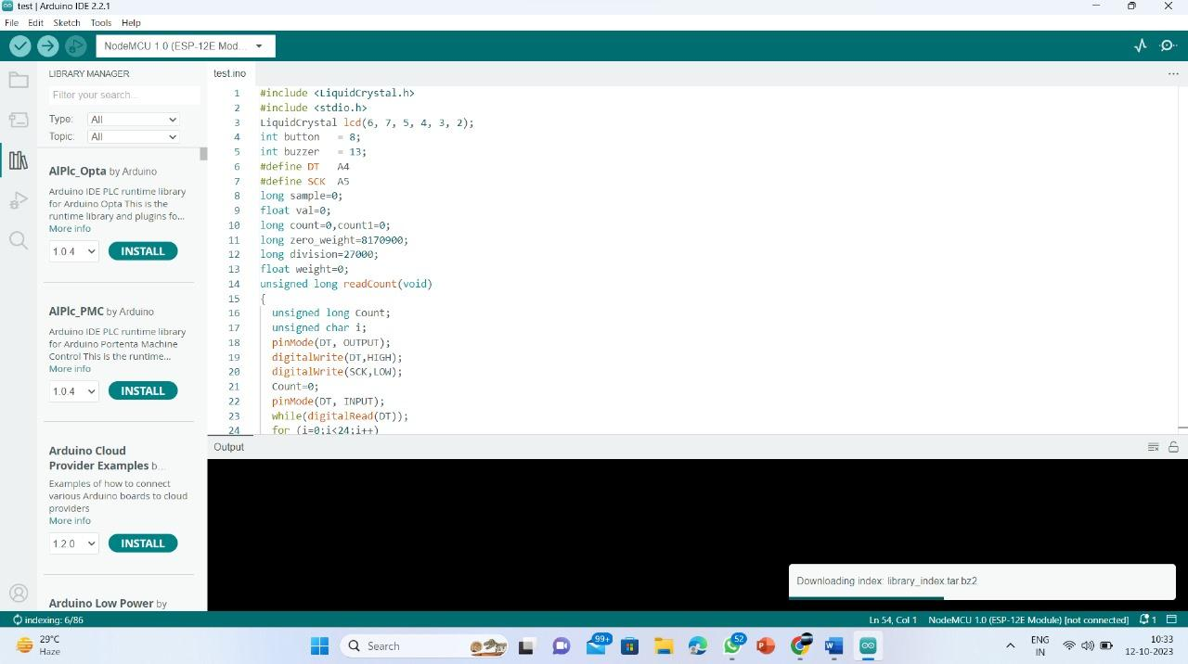
Sample code:

Slide 18
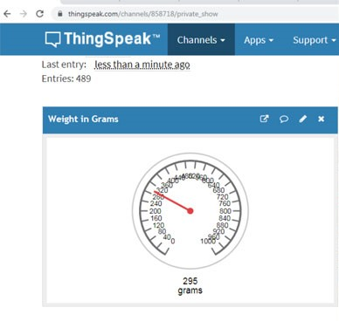
Experiment Results:

Slide 19
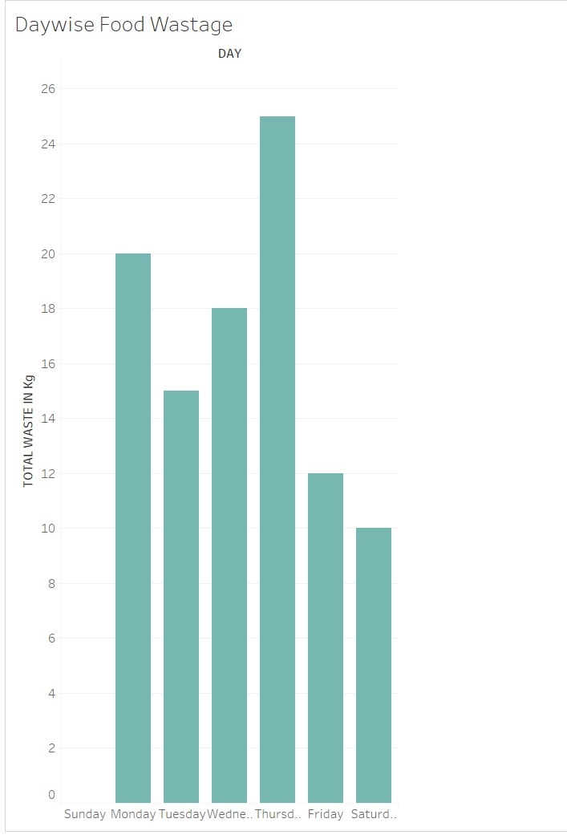
Experiment Results:

Slide 20
Conclusion:
Accurate and continuous monitoring of food wastage is essential because students often lack awareness of the food they are wasting. The implementation of this monitoring system plays a pivotal role in fostering behavioral change among individuals.
By visualizing and analyzing the data collected, the canteen management can gain valuable insights into the patterns of food wastage, which in turn facilitates efficient resource management.
This not only reduces food waste but also contributes to a more sustainable and cost-effective operation of the college canteen.

Slide 21
Thank you

